Slide 1




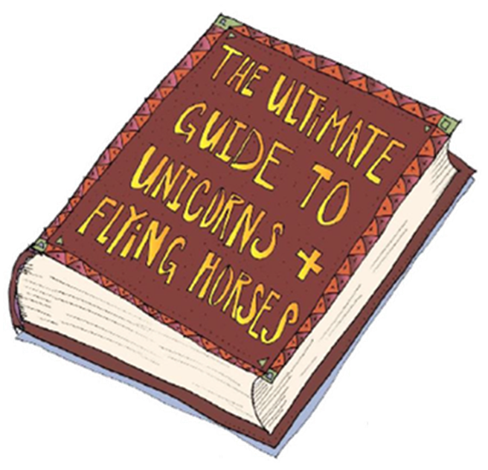

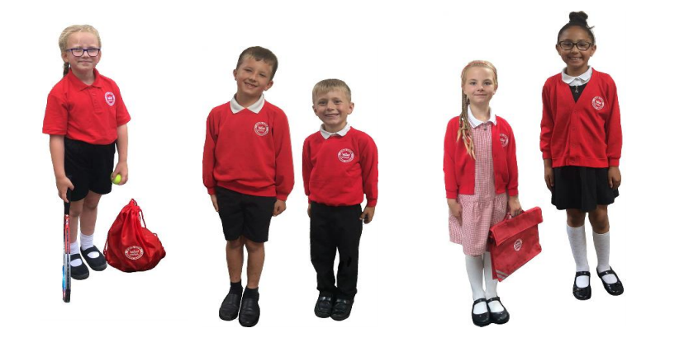


Year 6 Term 1
Ms Daniels
Mr Smith
Learning Journey: Who Let the Gods Out?
The year begins with a study of ancient Greece. We will learn about the rise and fall of their civilisation, its key achievements and its lasting legacy.
In art, we will explore traditional patterns including the geometric key and organic lotus leaf. Afterwards, we will design our own motif for screen printing.
In RE, we will explore theistic worldviews and compare them to those of atheists and agnostics, and in science, we will learn about electrical circuits and the impact that changing their components can have.
English
In English we will be writing to inform, to entertain and to discuss. We will cover the following text types:
Non-chronological reports
Explanation texts
Stories
Balanced arguments
Destination Reader
In DR, we will be reading ‘The Girl of Ink and Stars.’ It tells the story of Isabella Riosse, a 13-year-old who must save her island from Yote, the fire demon. It’s gripping tale of friendship and courage, and there are lots of opportunities to practise our skills of inference.
Maths
In maths, we will revisit place value. Working with numbers from 1 to 10 million, we will practise reading and writing, comparing, ordering and rounding. Afterwards, we will revisit the four operations, and long division will be introduced.
Computing
This term, we will develop in our understanding of online safety. In lesson 1, we will explore the risks and benefits of location-based services. In lesson 2, we will learn about digital footprints and how they can help or hinder us, and in lesson 3, we will discuss the importance of balance when it comes to screen time.
Wellbeing
In wellbeing, we will focus on ways to look after our physical and our mental health. Lessons will cover a range of topics including friendships, exercise and the importance of a balanced diet.
Support at home
Homework will be set on a Wednesday and is due the following Monday. Please encourage your child to watch the supporting videos, and to complete the activities set.
Read for at least 20 minutes each day. Remind your child to update their reading record and to quiz on Accelerated Reader.
Log in to Times Table Rockstars to practise for fluency.
Key information
PE is on a Wednesday. Children should arrive at school wearing their PE kit.
This term, we’ll be developing our reaction and response through a modified game of netball.
Parents evening will be held on Tues 15th and Wed 16th October.

