Slide 1







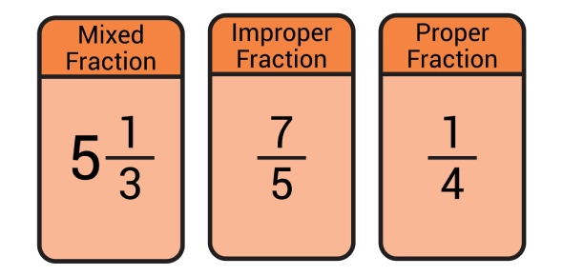

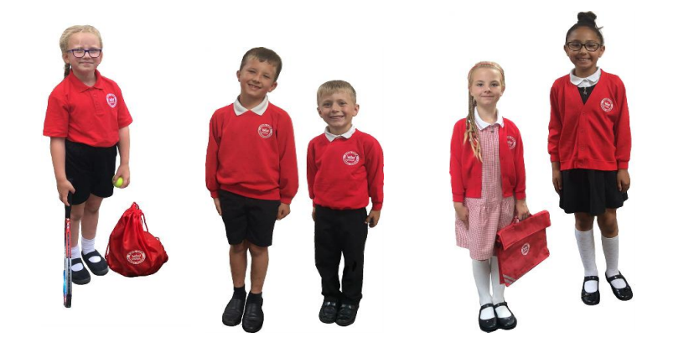


Year 6 Term 2
Ms Daniels
Mr Smith
Learning Journey: Who Let the Gods Out?
Our learning journey continues from term 1 into term 2.
In geography, we will be focusing on tourism. We will explore the features that attract tourists to Greece and Scotland, and we will consider the impact that tourism has.
In RE, we will read from the book of Genesis. We will discuss different interpretations of it, and we will compare the biblical account of creation to scientific explanations for our universe.
In design technology, we will plan, cost and make a meal that’s hot, savaoury and balanced, and in science, we’ll be learning about Earth and space.
English
This term, we will be writing suspense stories and explanation texts inspired by Skellig.
Destination Reader
In DR, we will read a range of classic and contemporary fiction.
Maths
In maths, we will consolidate our understanding of proper fractions, improper fractions and mixed numbers. First, we will practice the addition and subtraction of fractions, and, in the latter half of the term, we will learn to multiply and divide them by an integer.
Online safety
This term, we will be learning to code. We will use our skills to design a game and to create a simulation of a room.
Wellbeing
In wellbeing, we will continue to focus on ways to look after our physical and our mental health. Lessons will cover a range of issues including dental health, sleep, social media and the use of drugs.
Support at home
Homework will be set on a Wednesday and is due the following Monday. Please encourage your child to watch the supporting videos, and to complete the activities set.
Read for at least 20 minutes each day. Remind your child to update their reading record and to quiz on Accelerated Reader.
Log in to Times Table Rockstars to practise for fluency.
Key information
PE is on a Wednesday. Children should arrive at school wearing their PE kit.
In December, year 6 will take part in the Big Sing at the De La Warr. Details will be shared closer to the time.

